Slide 1
EMPLOYEE DATABASE MANAGEMENT SYSTEM
C PROJECT

Slide 2
CONTENTS
Abstract
Introduction
Modules Used
Login
Add
Deletee
Modify
Display
Menu
Algorithm
Flowchart
Code
Output
Conclusion
PS: Click on text to go on that respective page.

Slide 3
Abstract
This report includes a development presentation of an information system for managing the staff data within a small company or organization. The system as such as it has been developed is called Employee Management System.
Back to Contents

Slide 4
Introduction
The entire System of Employee Management (EMS) is designed to remove problems in existing system and the organization will meet its specific aims. One of the most important aims from the system is to provide detail profile of each employee. As a result the system is most important for improving other systems of organization like human resources management.
The role of EMS is to centralize the repository of staff data including details and salary. An effective Employee Management System helps to generate accurate and timely employee information to fulfill the objectives.
It manages salary of employee according to the attendance. It also focuses on the capabilities and facilities provided by the company. Without an employee management system it is tedious to control employees.
Back to Contents

Slide 5
Modules Used
1.Login
2.Add
3.Deletee
4.Modify
5.Display
6.Menu
7.gotoxy
Back to Contents
NOTE: Pls click on respective icon to go to that module.

Slide 6
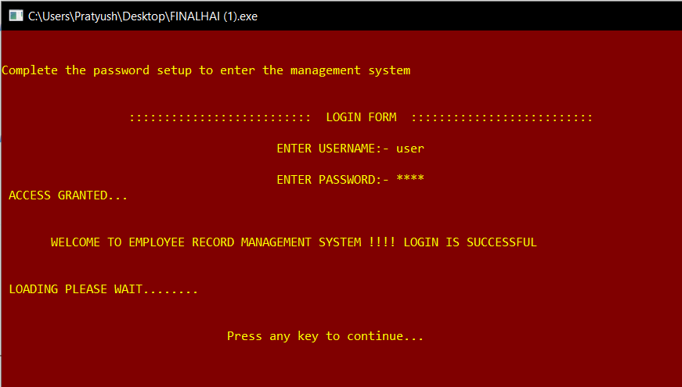
Void login()
This module is designed for a login screen that will read and validate username, password with given values.
In this program we will design a login screen to check username and password, password will display as password characters (‘*’) and here backspace key will also work.
It shows SUCCESSFUL OR UNSUCCESSFUL based on the input
Back to Modules

Slide 7
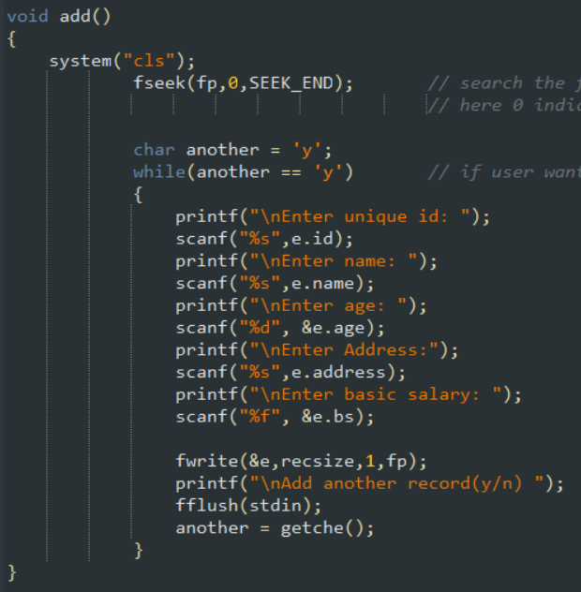
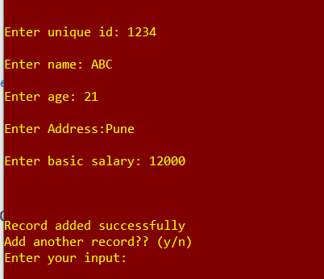
Void Add()
It is designed to input new record from the user.
User enters the following:
Name
ID
Age
Address
Salary
It also asks that whether user wants to enter another record or not
Back to Modules

Slide 8
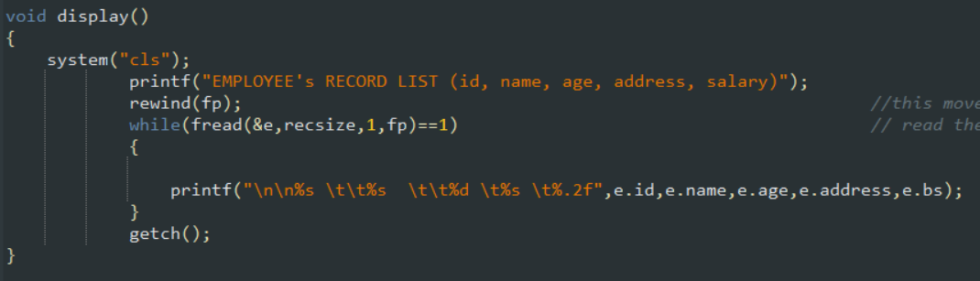
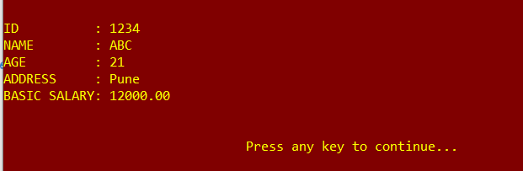
Void Display()
It is designed to display the list of records which are currently in the system.
Record is identified on the basis of unique ID.
Deleted records will no longer be displayed in the list
Back to Modules

Slide 9
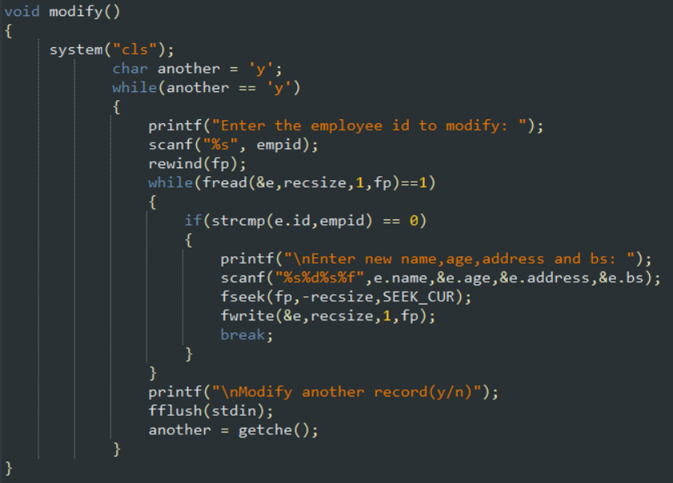
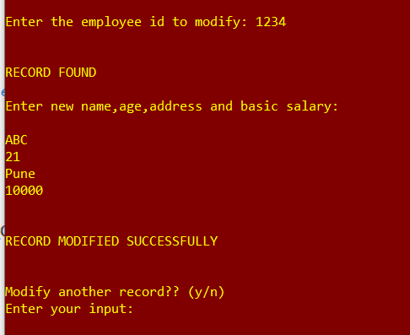
Void Modify()
It is designed to modify the current records of the employee
It is identified based on the ID
After changes the record are updated.
It also asks the user whether we want to modify another record or not.
Back to Modules

Slide 10
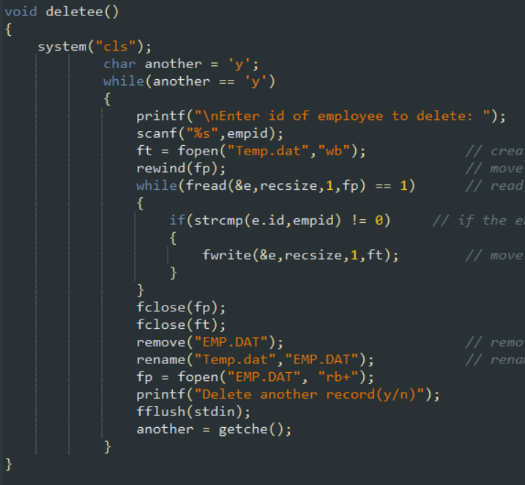
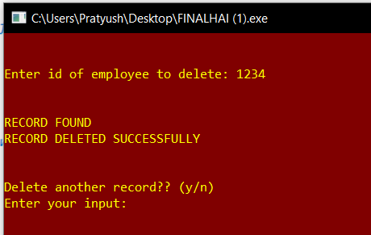
Void Deletee()
It is designed to delete the record which is already in the system
Record is identified on the basis of ID
After that record will be deleted from the employee’s list
It also asks whether we want to delete another record or not.
Back to Modules

Slide 11
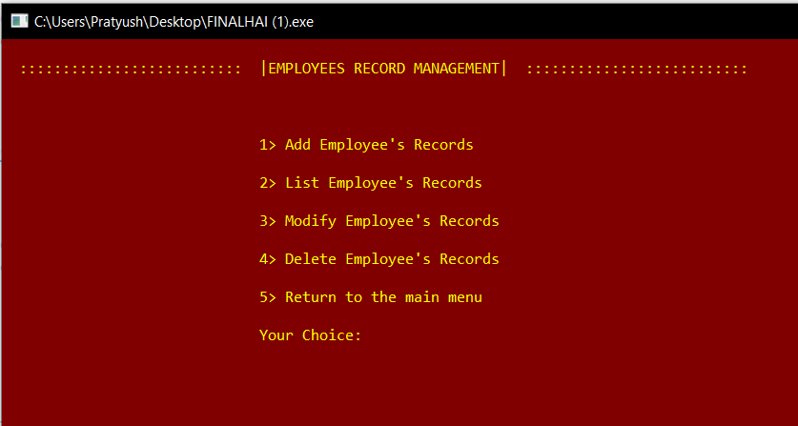
Void Menu()
It is the menu page where all the various are present.
User can input his choice to perform a certain operation.
It shows:
Add Records
Delete Records
Modify Records
List Records
And Exit System.
Back to Modules

Slide 12
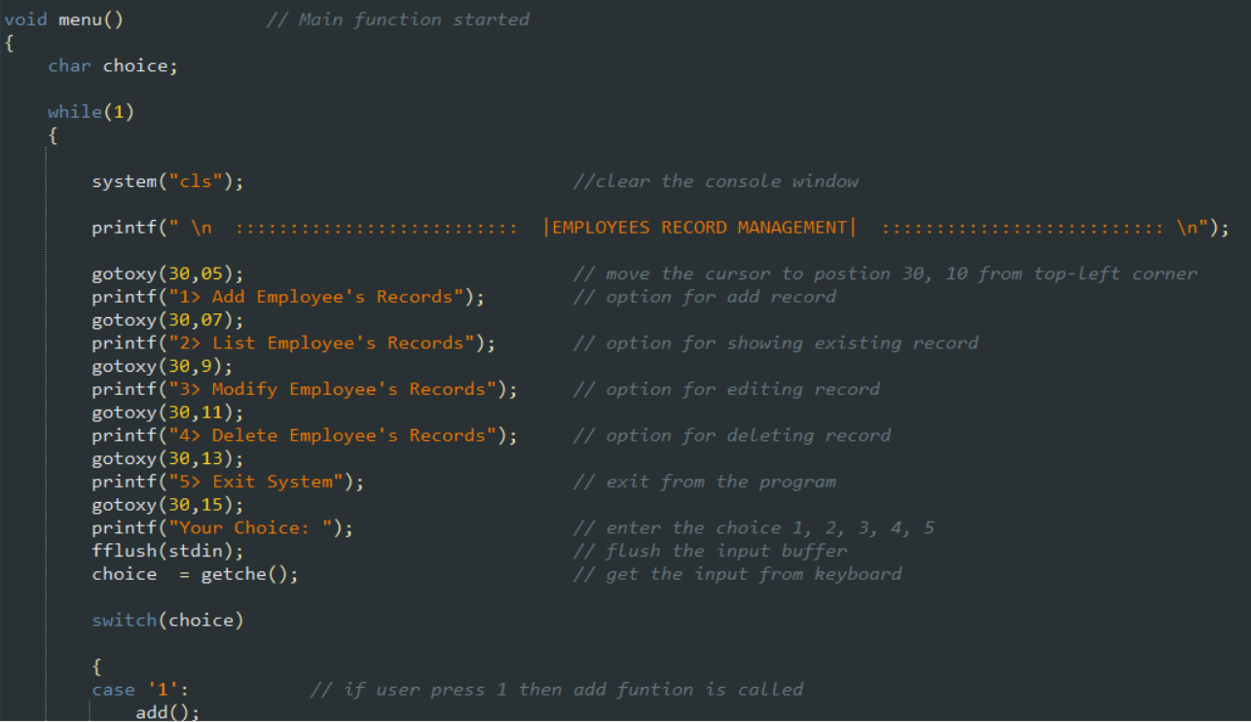
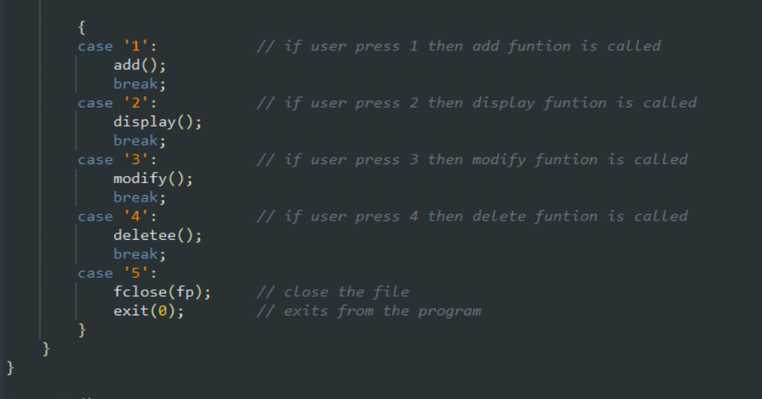
Void Menu()
Back to Modules

Slide 13
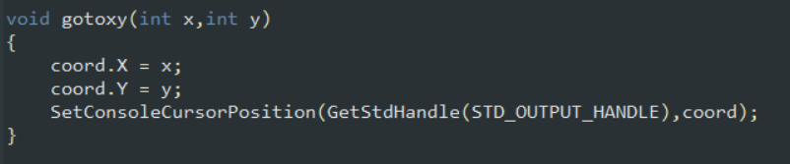
Void gotoxy()
It is designed to place the cursor on the main page.
Gotoxy function places cursor at a desired location on screen i.e., we can change cursor position using gotoxy function.
void gotoxy(int x, int y);
where (x, y) is the position where we want to place the cursor.
Back to Modules

Slide 14
ALGORITHM
Main
Step 1: Start.
Step 2: To go to “Admin” press 1. To “Exit” the program press 2.
Step 3: If entered 1, complete the password setup to enter the management system.
Step 4: Enter username and password then press any key to continue to “Employee’s Record Management”.
Step 5: If you wish to “Add Employee’s Records” press 1. Execute module of “add”.
Step 6: Else If you wish to “List Employee’s Records” press 2. Execute module of “display”.
Step 7: Else If you wish to “Modify Employee’s Records” press 3. Execute module of “modify”.
Step 8: Else If you wish to “Delete Employee’s Records” press 4. Execute module of “deletee”.
Step 9: Else you wish to “Return to Main Menu” press 5. Go to Step 2.
Back to Contents

Slide 15
ADD
DISPLAY
Step 1: Start.
Step 2: Enter unique id.
Step 3: Enter name.
Step 4: Enter age.
Step 5: Enter address.
Step 6: Enter Basic Salary.
Step 7: If “Y” (yes) to enter another record, go to step 2.
Else go to “Employee’s Record Management”.
Step 8: Stop.
Step 1: Start.
Step 2: Display all the records entered in “Employee’s Records”.
Step 3: Stop

Slide 16
MODIFY
DELETEE
Step 1: Start
Step 2: Enter the id you want to change.
Step3: Enter new name, age, address and basic salary.
Step 4: If “Y” (yes) to modify another record, go to step 2.
Else go to “Employee’s Record Management”.
Step 5: Stop.
Step 1: Start
Step 2: Enter the id number which u want to delete.
Step 3: If “Y” (yes) to delete another record, go to step 2.
Else go to “Employee’s Record Management”.
Step 4: Stop.

Slide 17
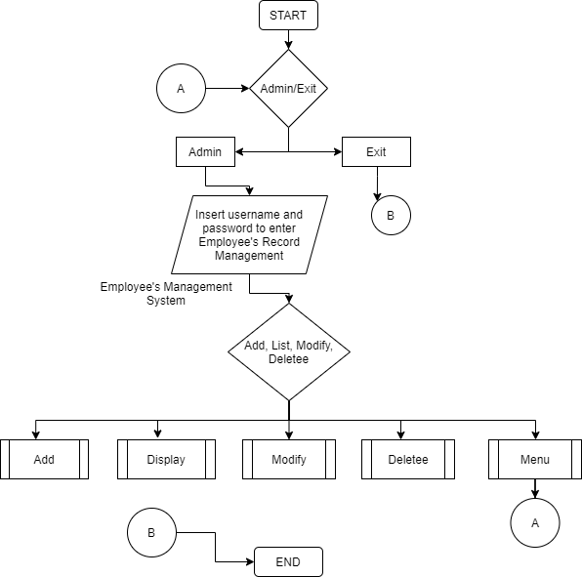
FLOWCHART
MAIN
Back to Contents

Slide 18
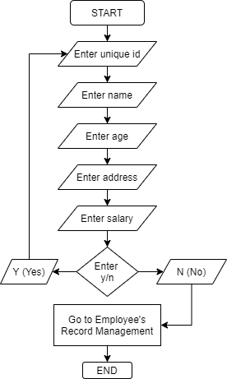
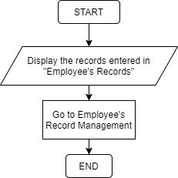
ADD
DISPLAY

Slide 19
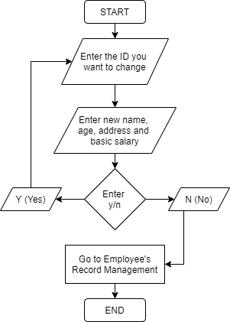
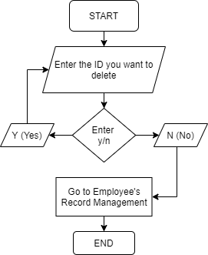
Modify
DELETEE

Slide 20
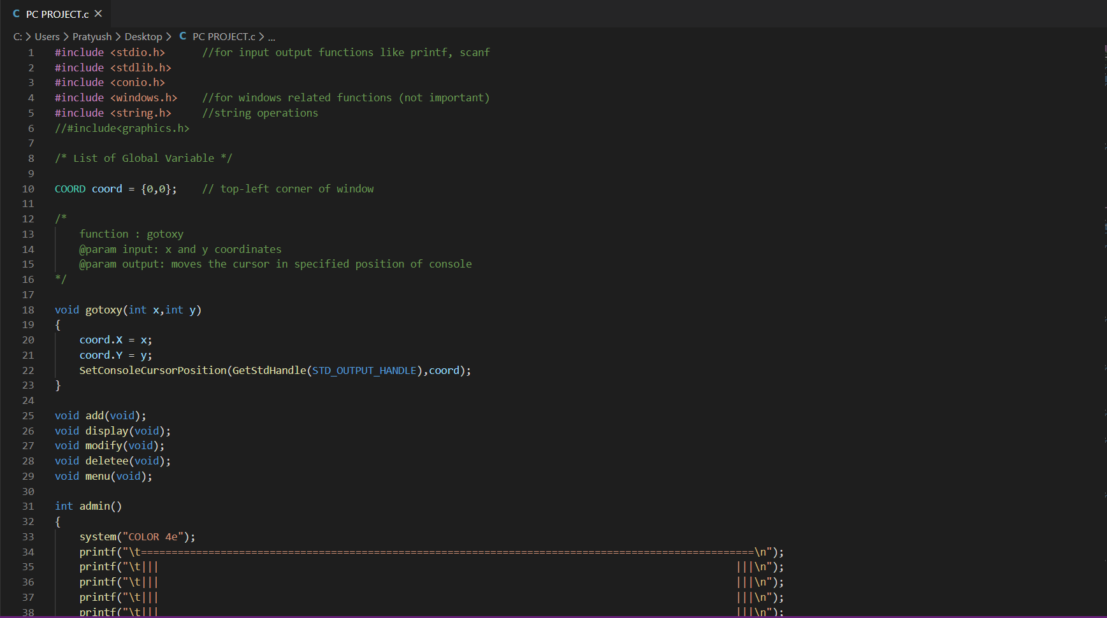
CODE
Back to Contents

Slide 21
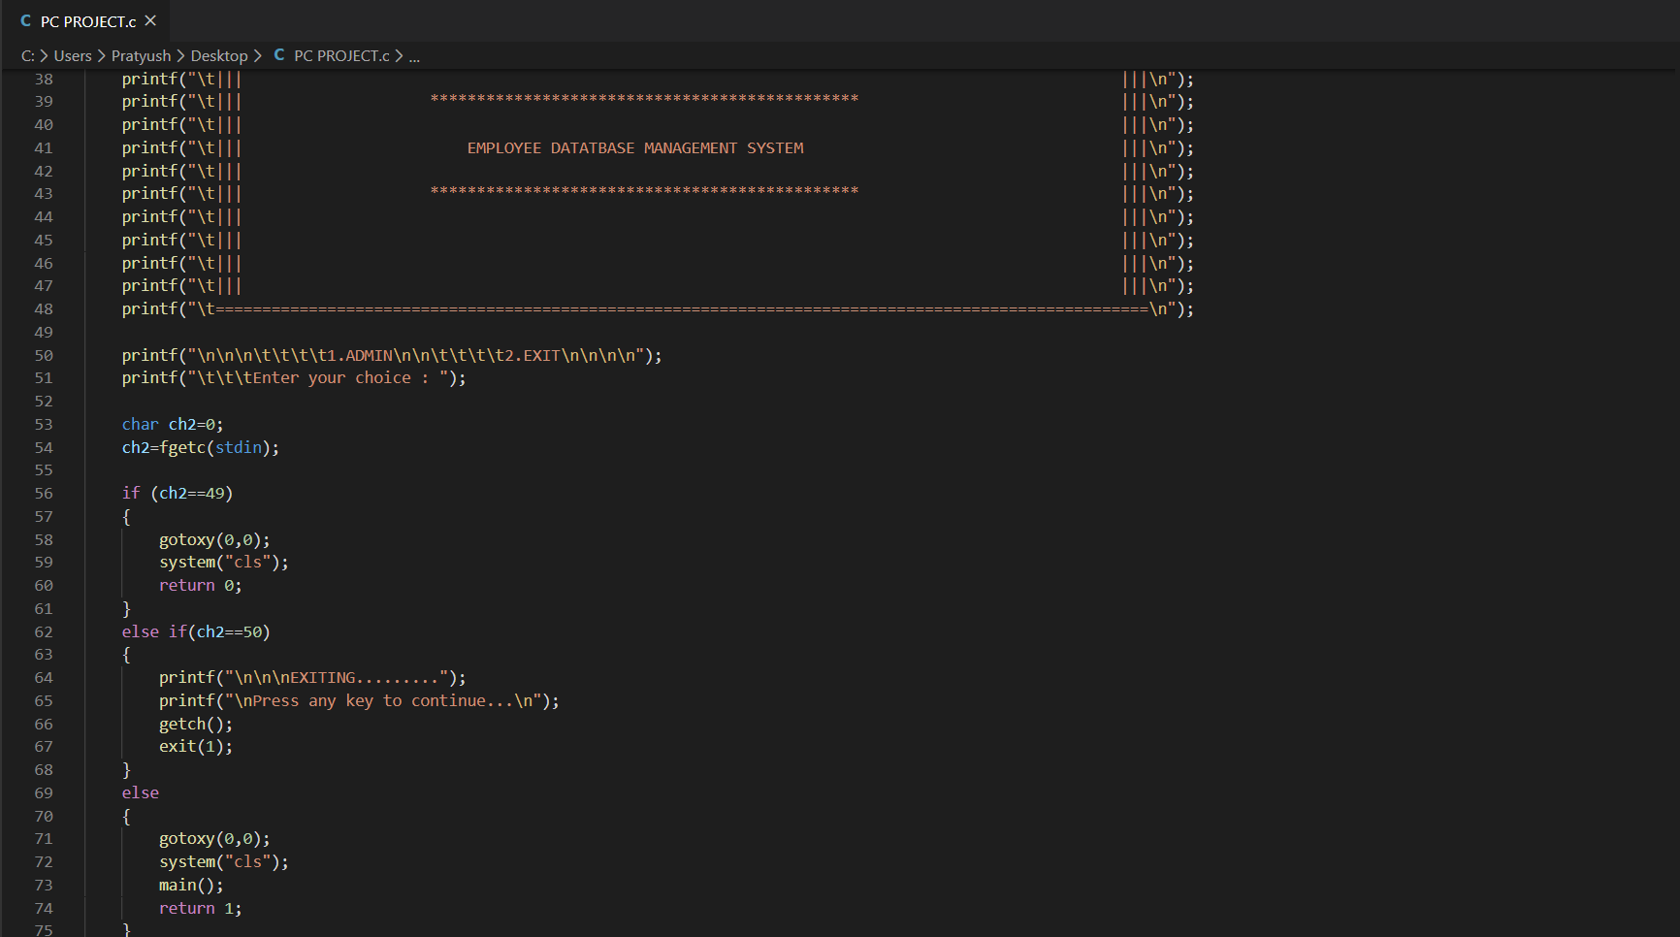

Slide 22
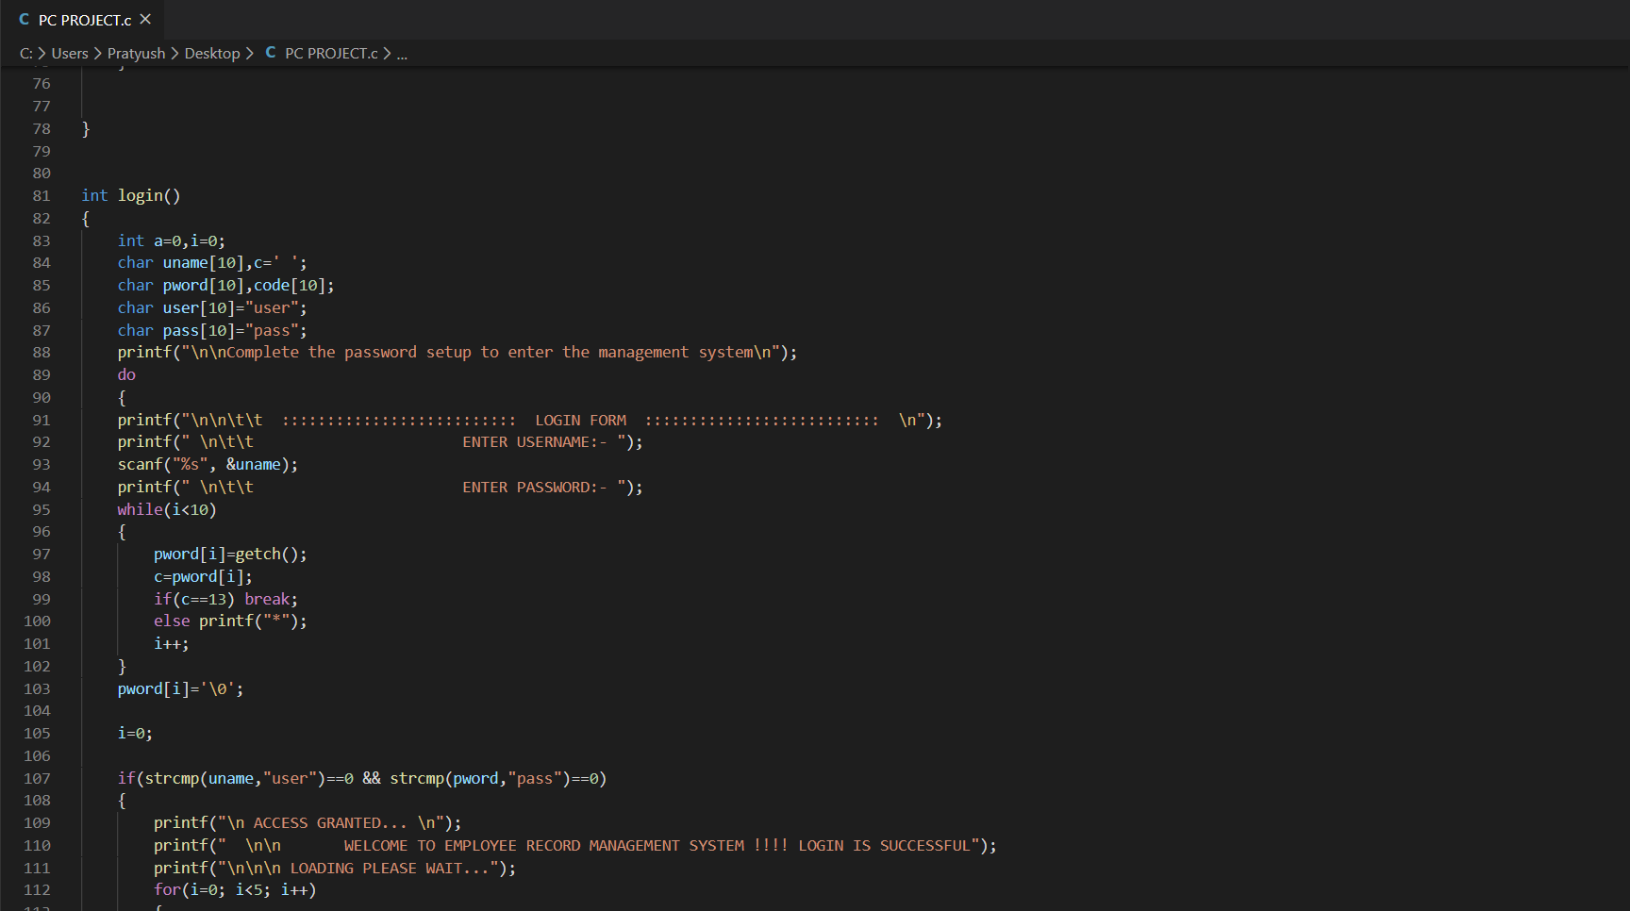

Slide 23
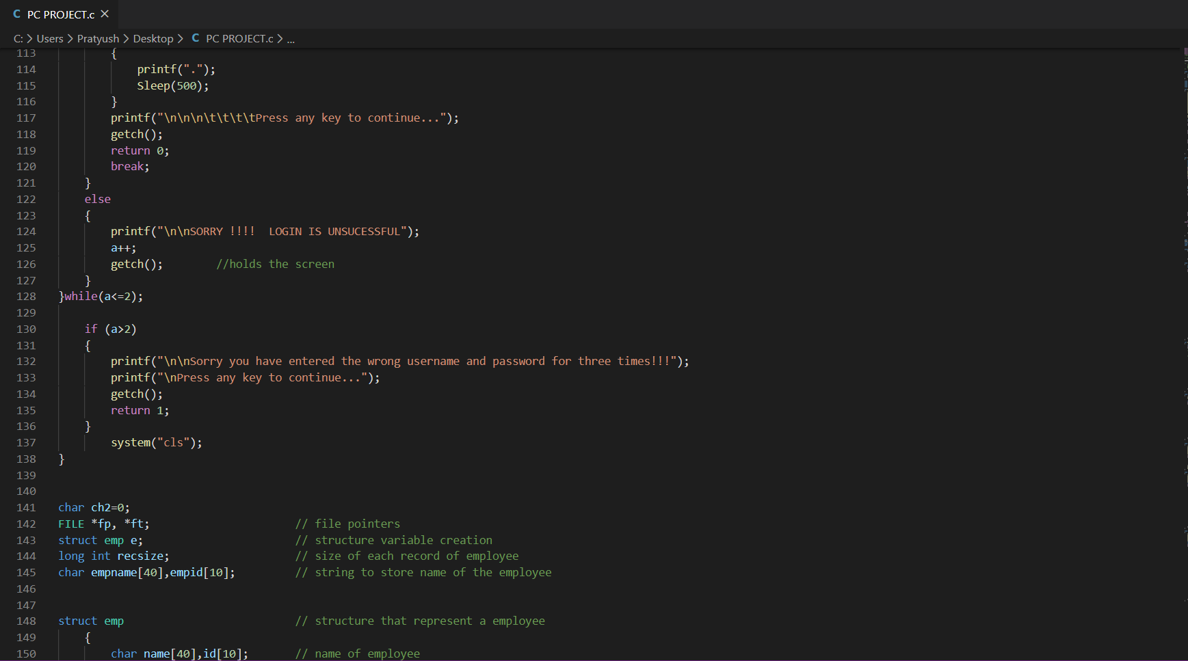

Slide 24
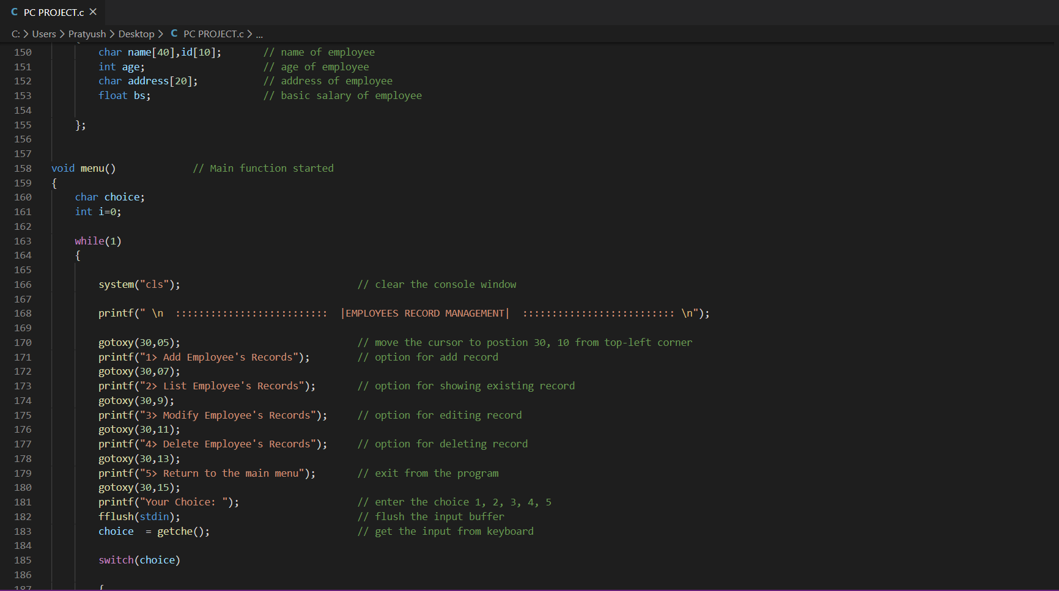

Slide 25
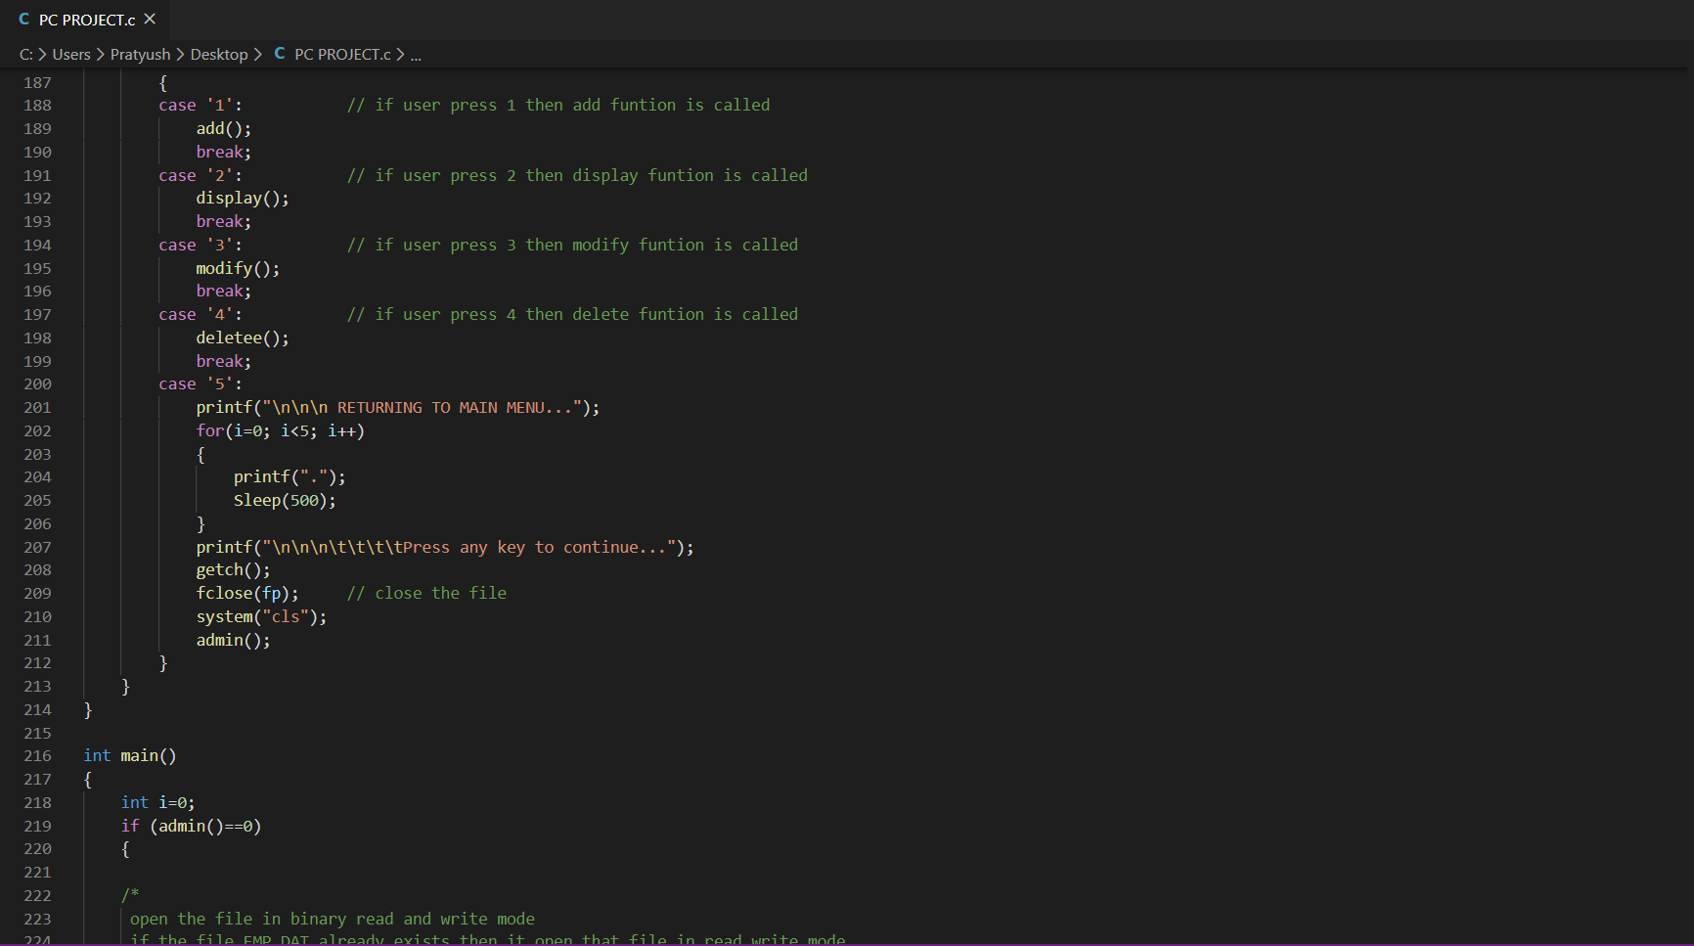

Slide 26
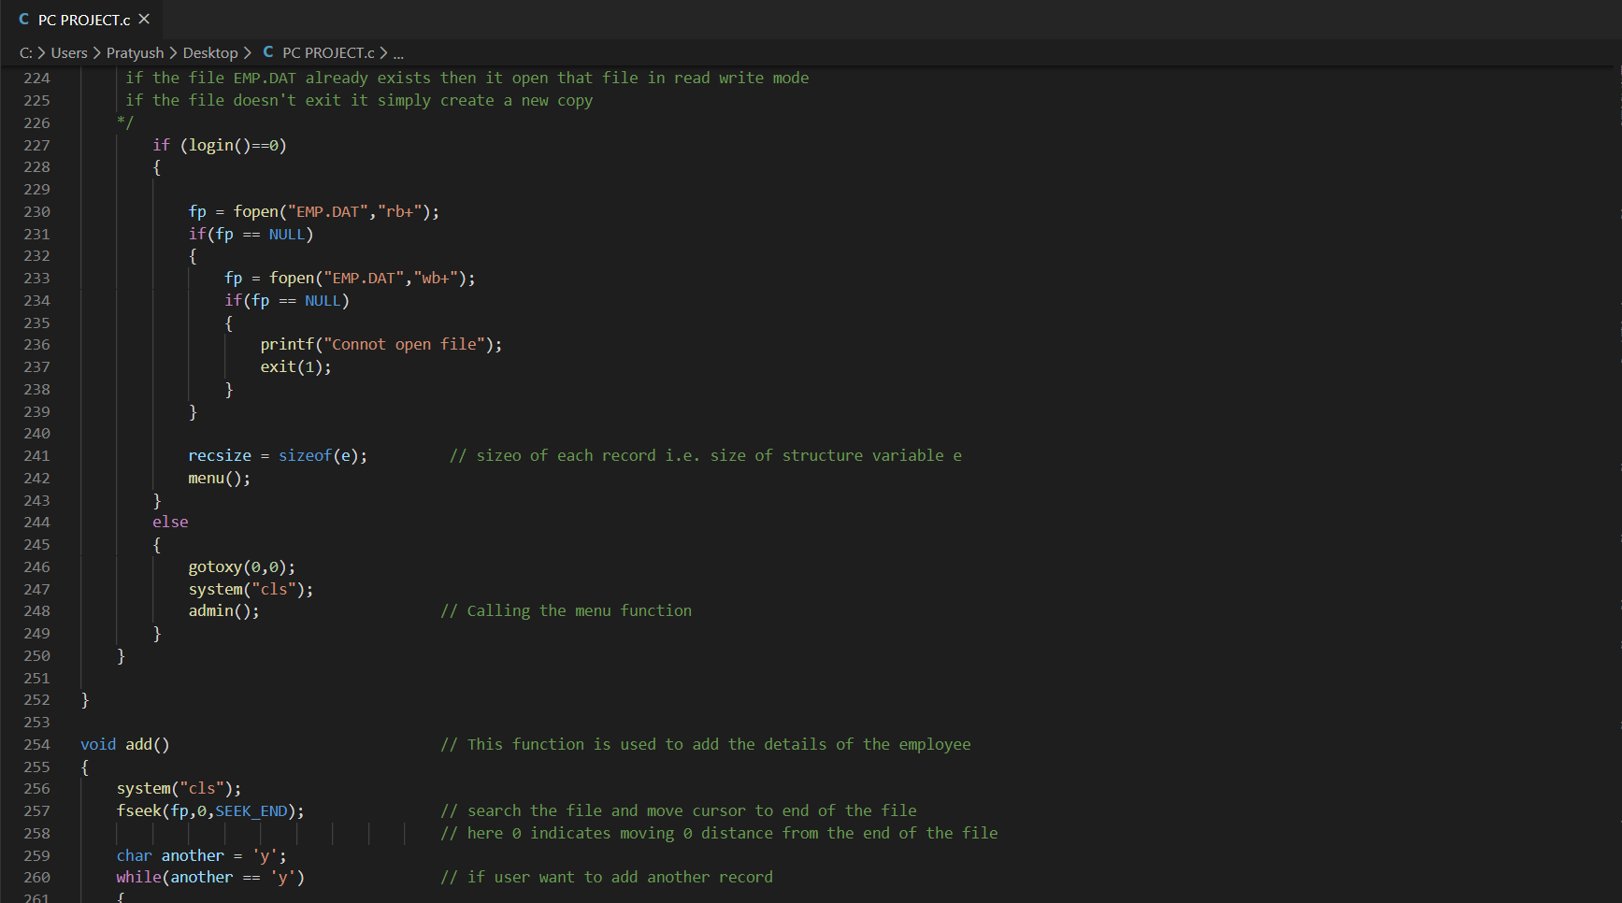

Slide 27
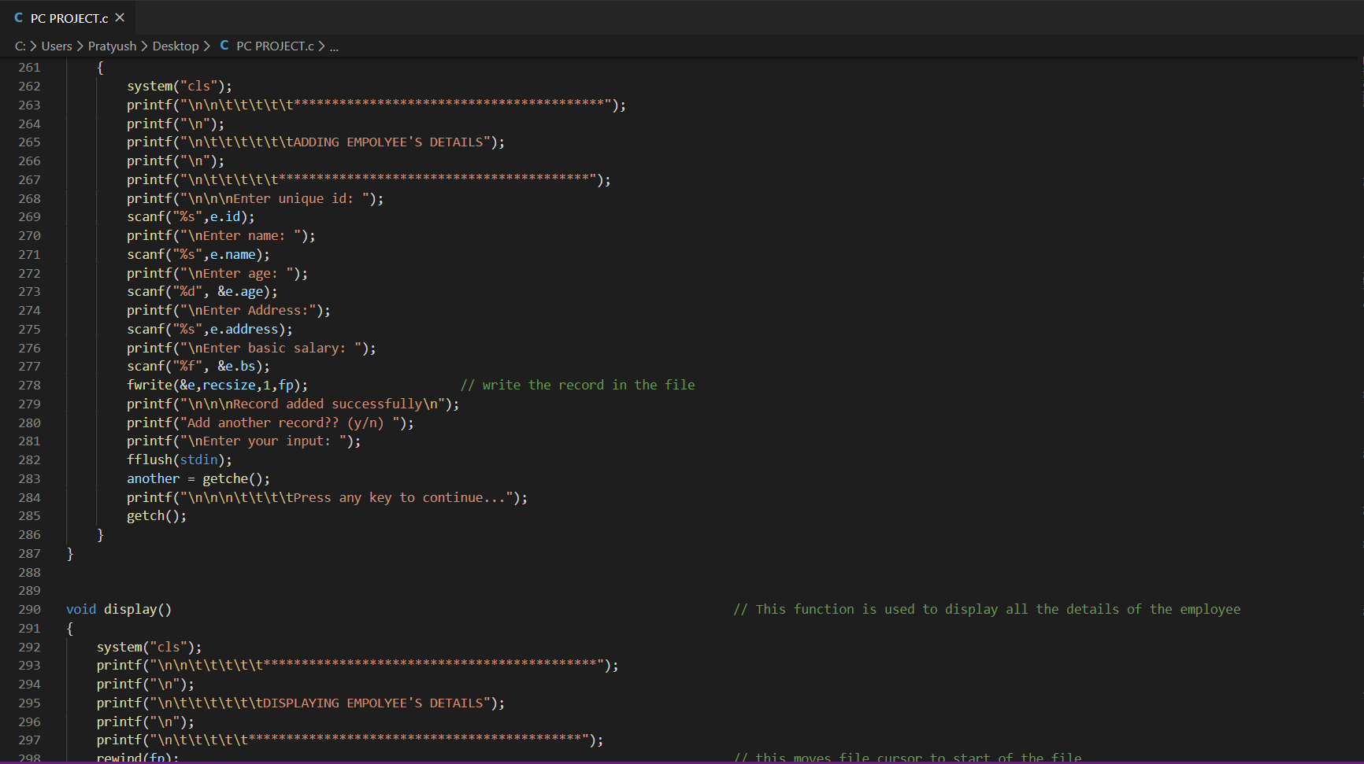

Slide 28
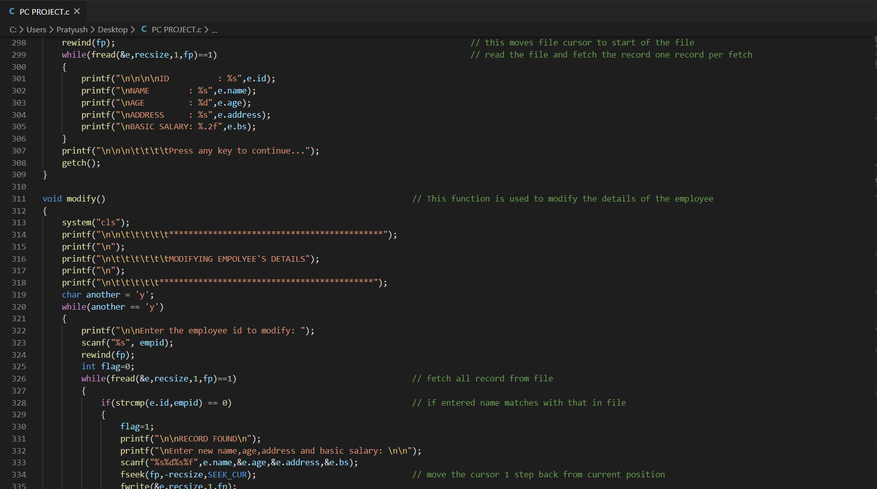

Slide 29
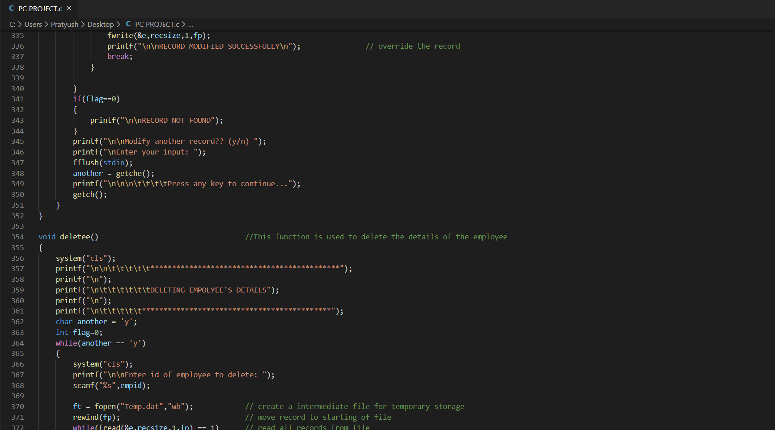

Slide 30
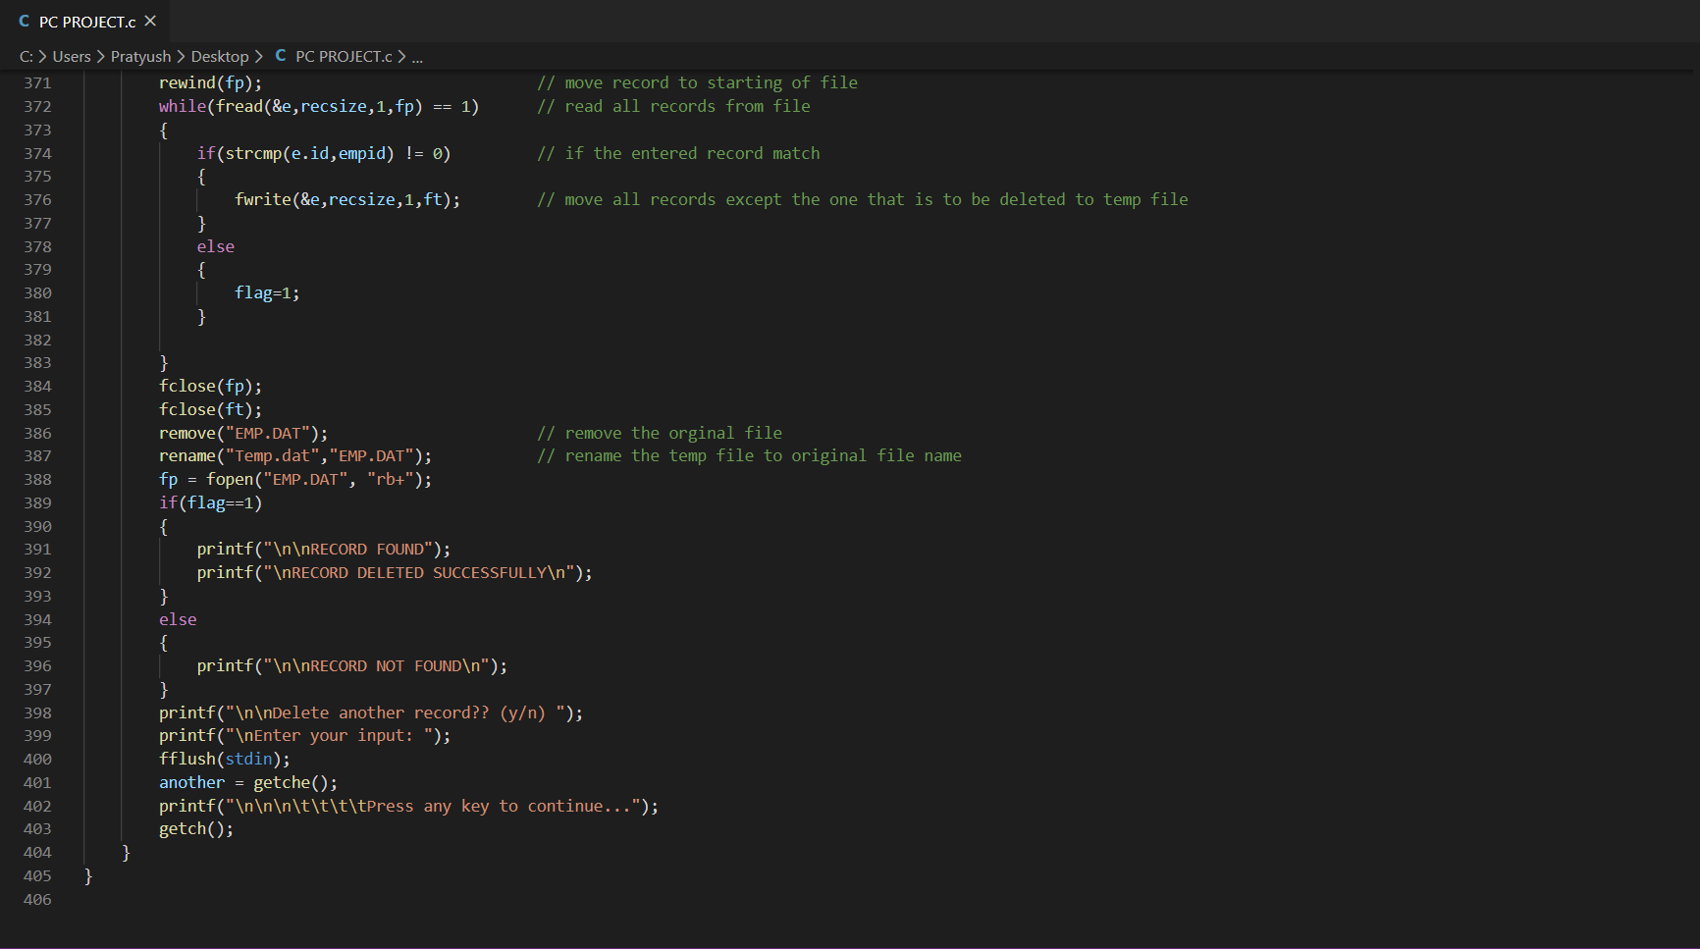

Slide 31
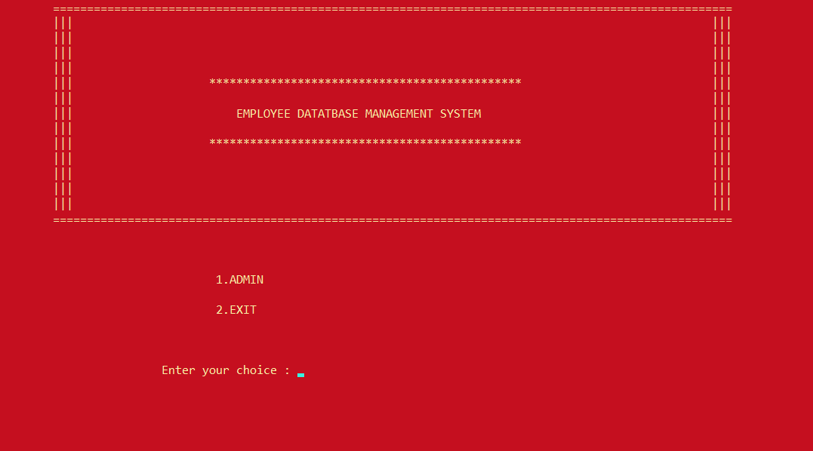
OUTPUT
This is the Admin Page which appears on starting the program.
Back to Contents

Slide 32
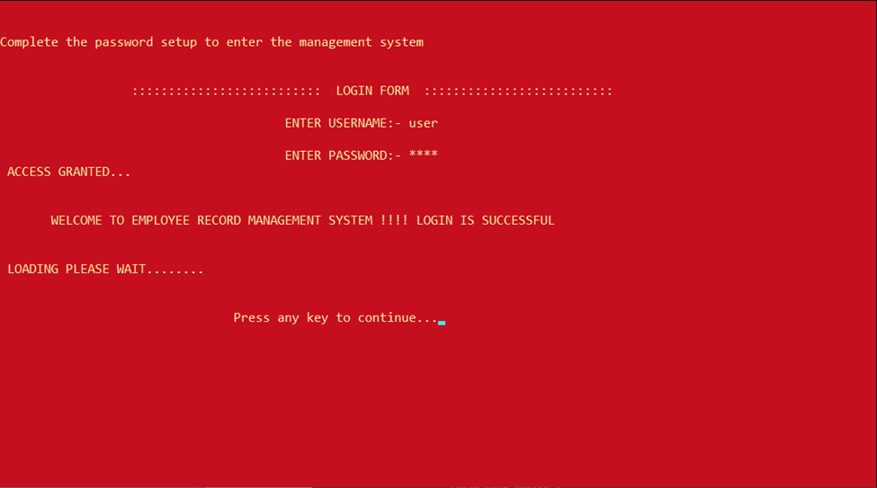
The user is granted permission after entering correct credentials.
Back to Contents

Slide 33
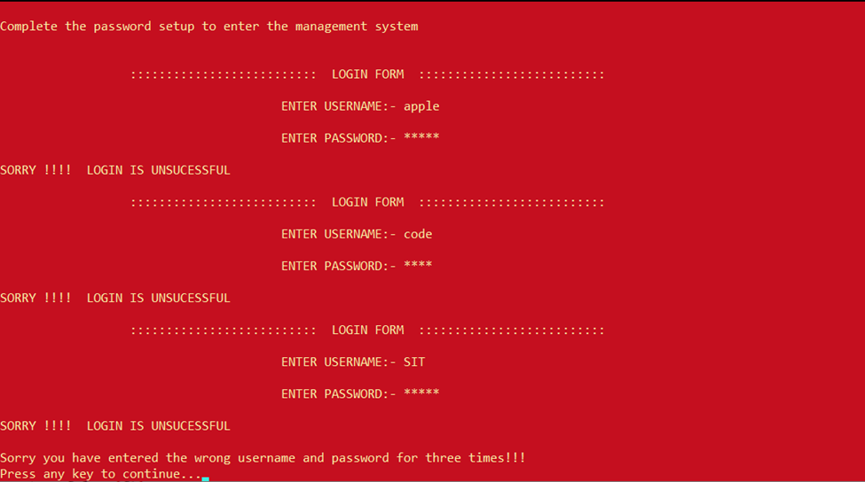
Login is unsuccessful if credentials are wrong.
Back to Contents

Slide 34
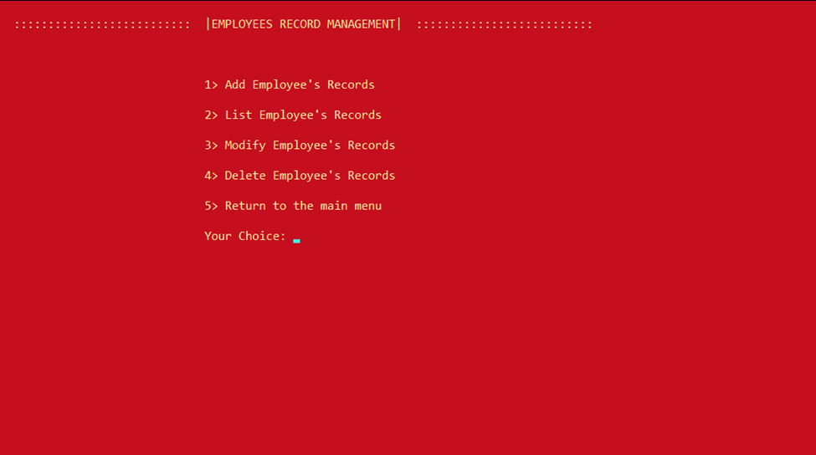
The main menu of the program.
Back to Contents

Slide 35
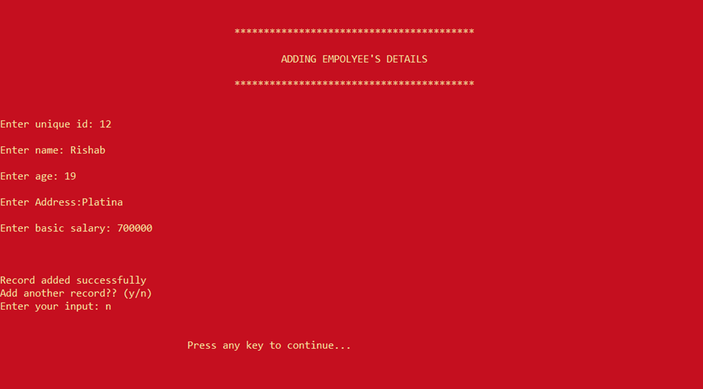
Adding the details after choosing the Add option.
Back to Contents

Slide 36
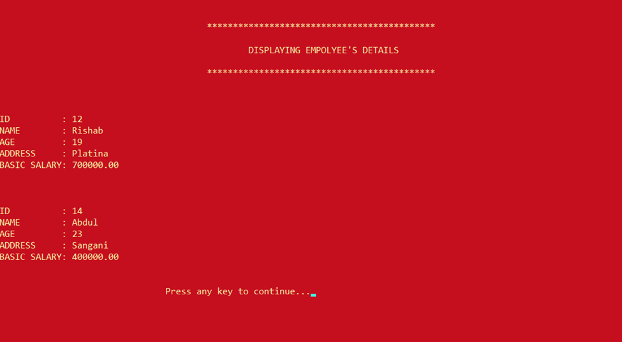
Displaying the records after choosing the Display option.
Back to Contents

Slide 37
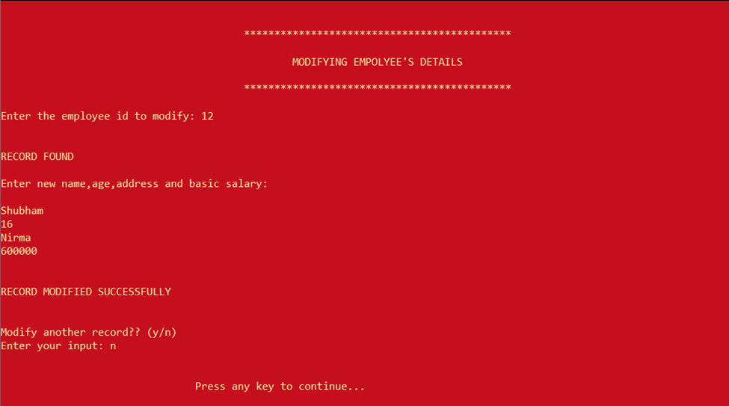
Record found & modifying the records after choosing the Modify option.
Back to Contents

Slide 38
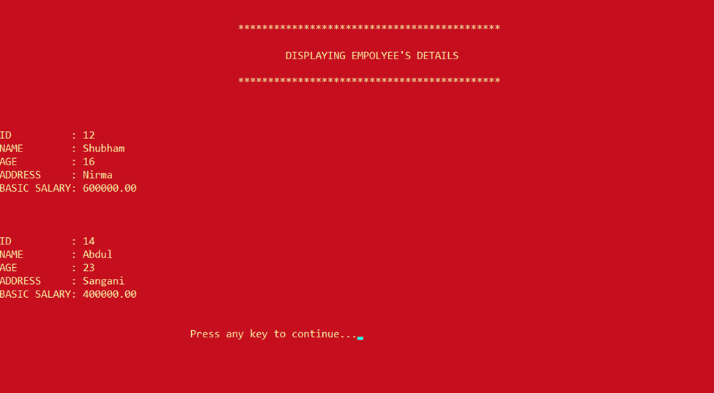
Records after the modifications have been made.
Back to Contents

Slide 39
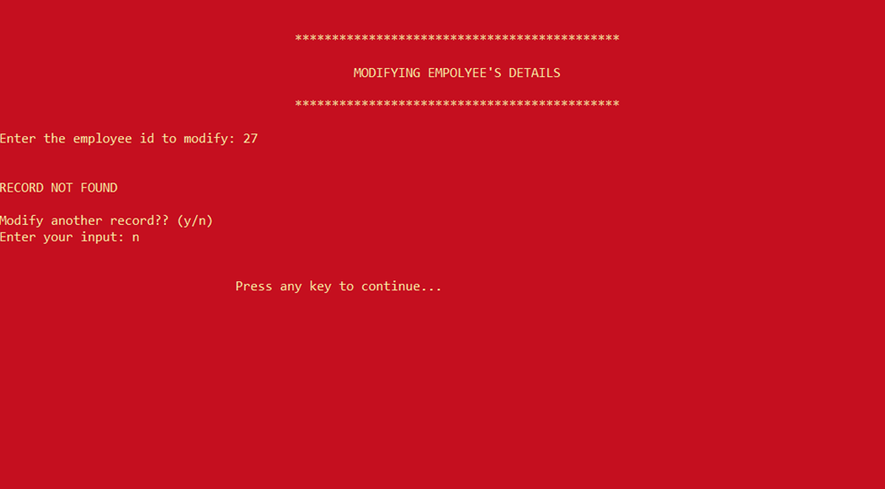
Record not found as the ID was wrong, hence can’t modify record.
Back to Contents

Slide 40
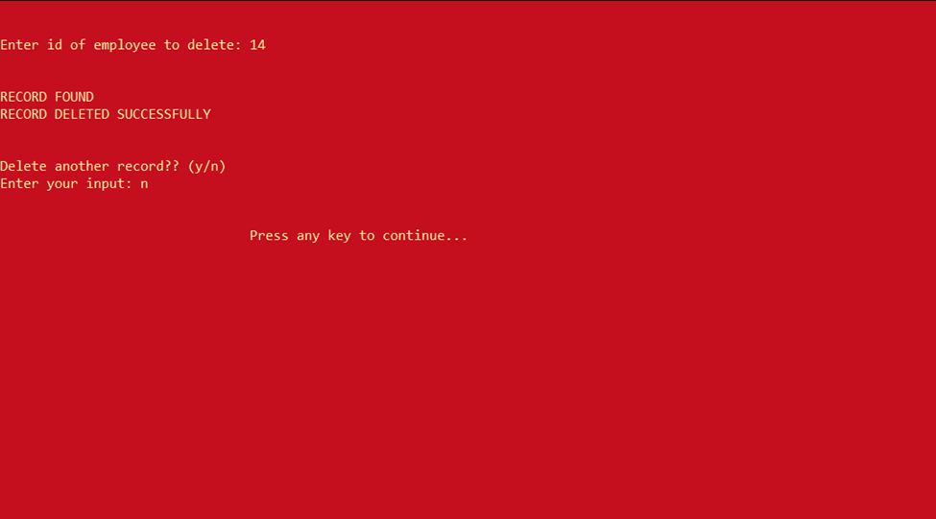
Record found and was deleted .
Back to Contents

Slide 41
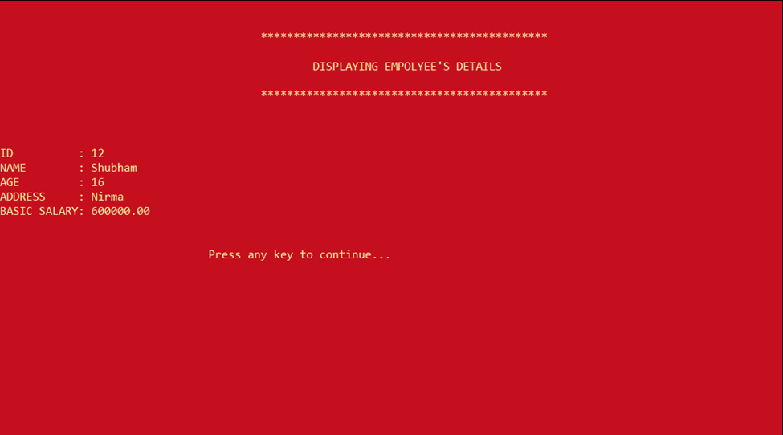
Records list after deleting a record.
Back to Contents

Slide 42
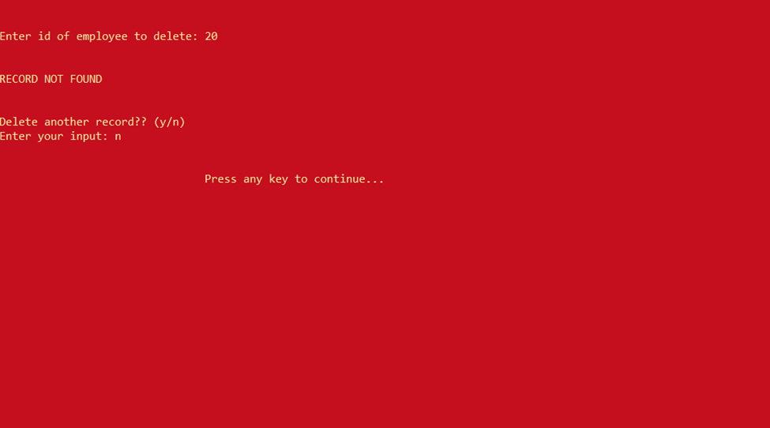
Records not found, hence can’t delete the record.
Back to Contents

Slide 43
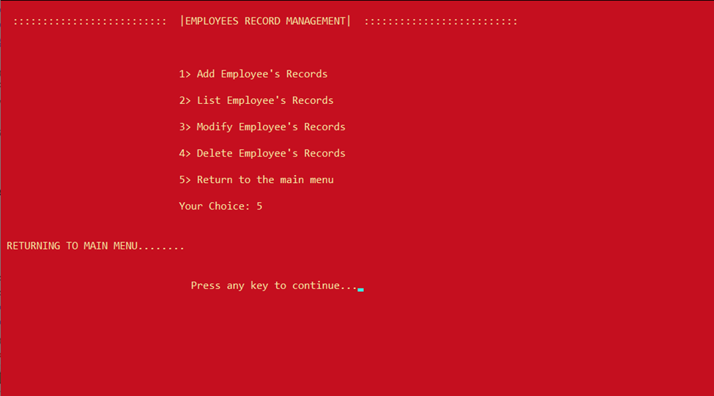
Returning to the Admin Page from Main menu .
Back to Contents

Slide 44
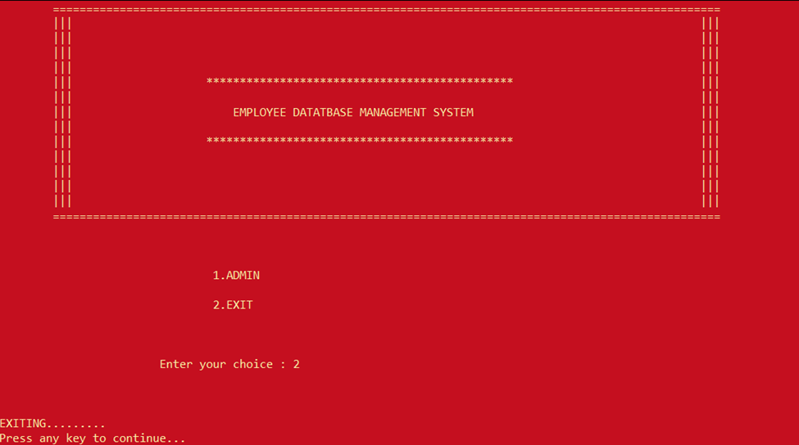
Exiting the program.
Back to Contents

Slide 45
Conclusion
It was a great experience to design and implement the Employee Management System using the C language and to work on its documentation. We learned how to apply concepts of C in modern day systems.
This project helped us to get better understanding to develop and organize basic programming concepts of C language such as loops, control structures, arrays, file handling etc.
Back to Contents

Slide 46



Contributors
Sudhanshu Pandey
Prakhar Agarwal
Pratyush Jain
Rahul Mansharamani

